Slide 1


SMART INDIA HACKATHON 2024
AGROVISION
Problem Statement ID – 1647
Problem Statement Title- Development of AI-ML based models for predicting prices of agri-horticultural commodities such as pulses and vegetable (onion, potato, onion)
Theme- Agriculture, FoodTech & Rural Development
PS Category- Software
Team ID-
Team Name (Registered on portal): codeXcyphers

Slide 2

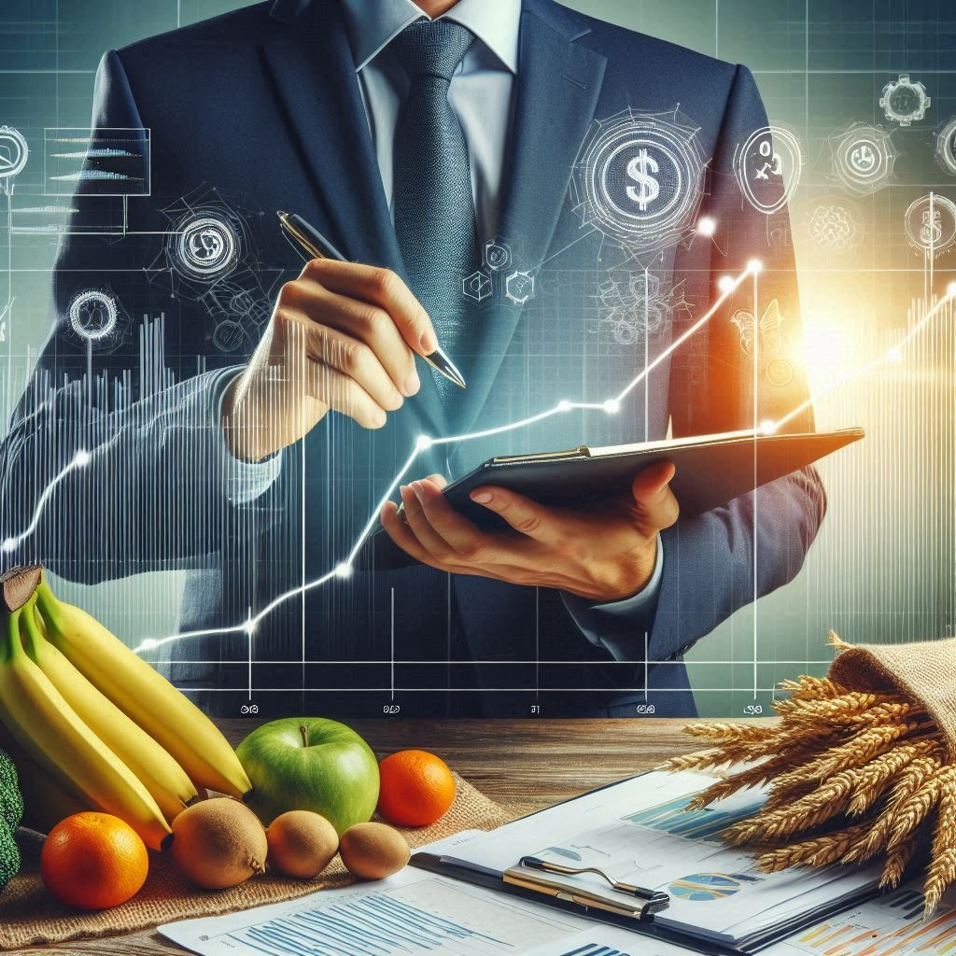
AGROVISION
IDEA/SOLUTION :
This research focuses on developing an AI-ML model that predicts the prices of agri-horticultural commodities such as pulses and vegetables. Traditional methods fail to capture the volatility caused by market dynamics, climate conditions, and supply-demand fluctuations. The AI-ML model will incorporate multiple datasets including historical price data, weather patterns, crop yields, and global market trends to offer accurate price forecasts.
PROBLEM RESOLUTION:
Reduces manual analysis, making forecasting faster, more efficient, and scalable for quicker decision-making
UNIQUE VALUE PROPOSITION :
Our solution combines advanced AI-ML algorithms with agricultural price prediction, outperforming traditional models like ARIMA by recognizing long-term dependencies and non-linear patterns using LSTMs and regression models.
@SIH Idea submission- Template

Slide 3
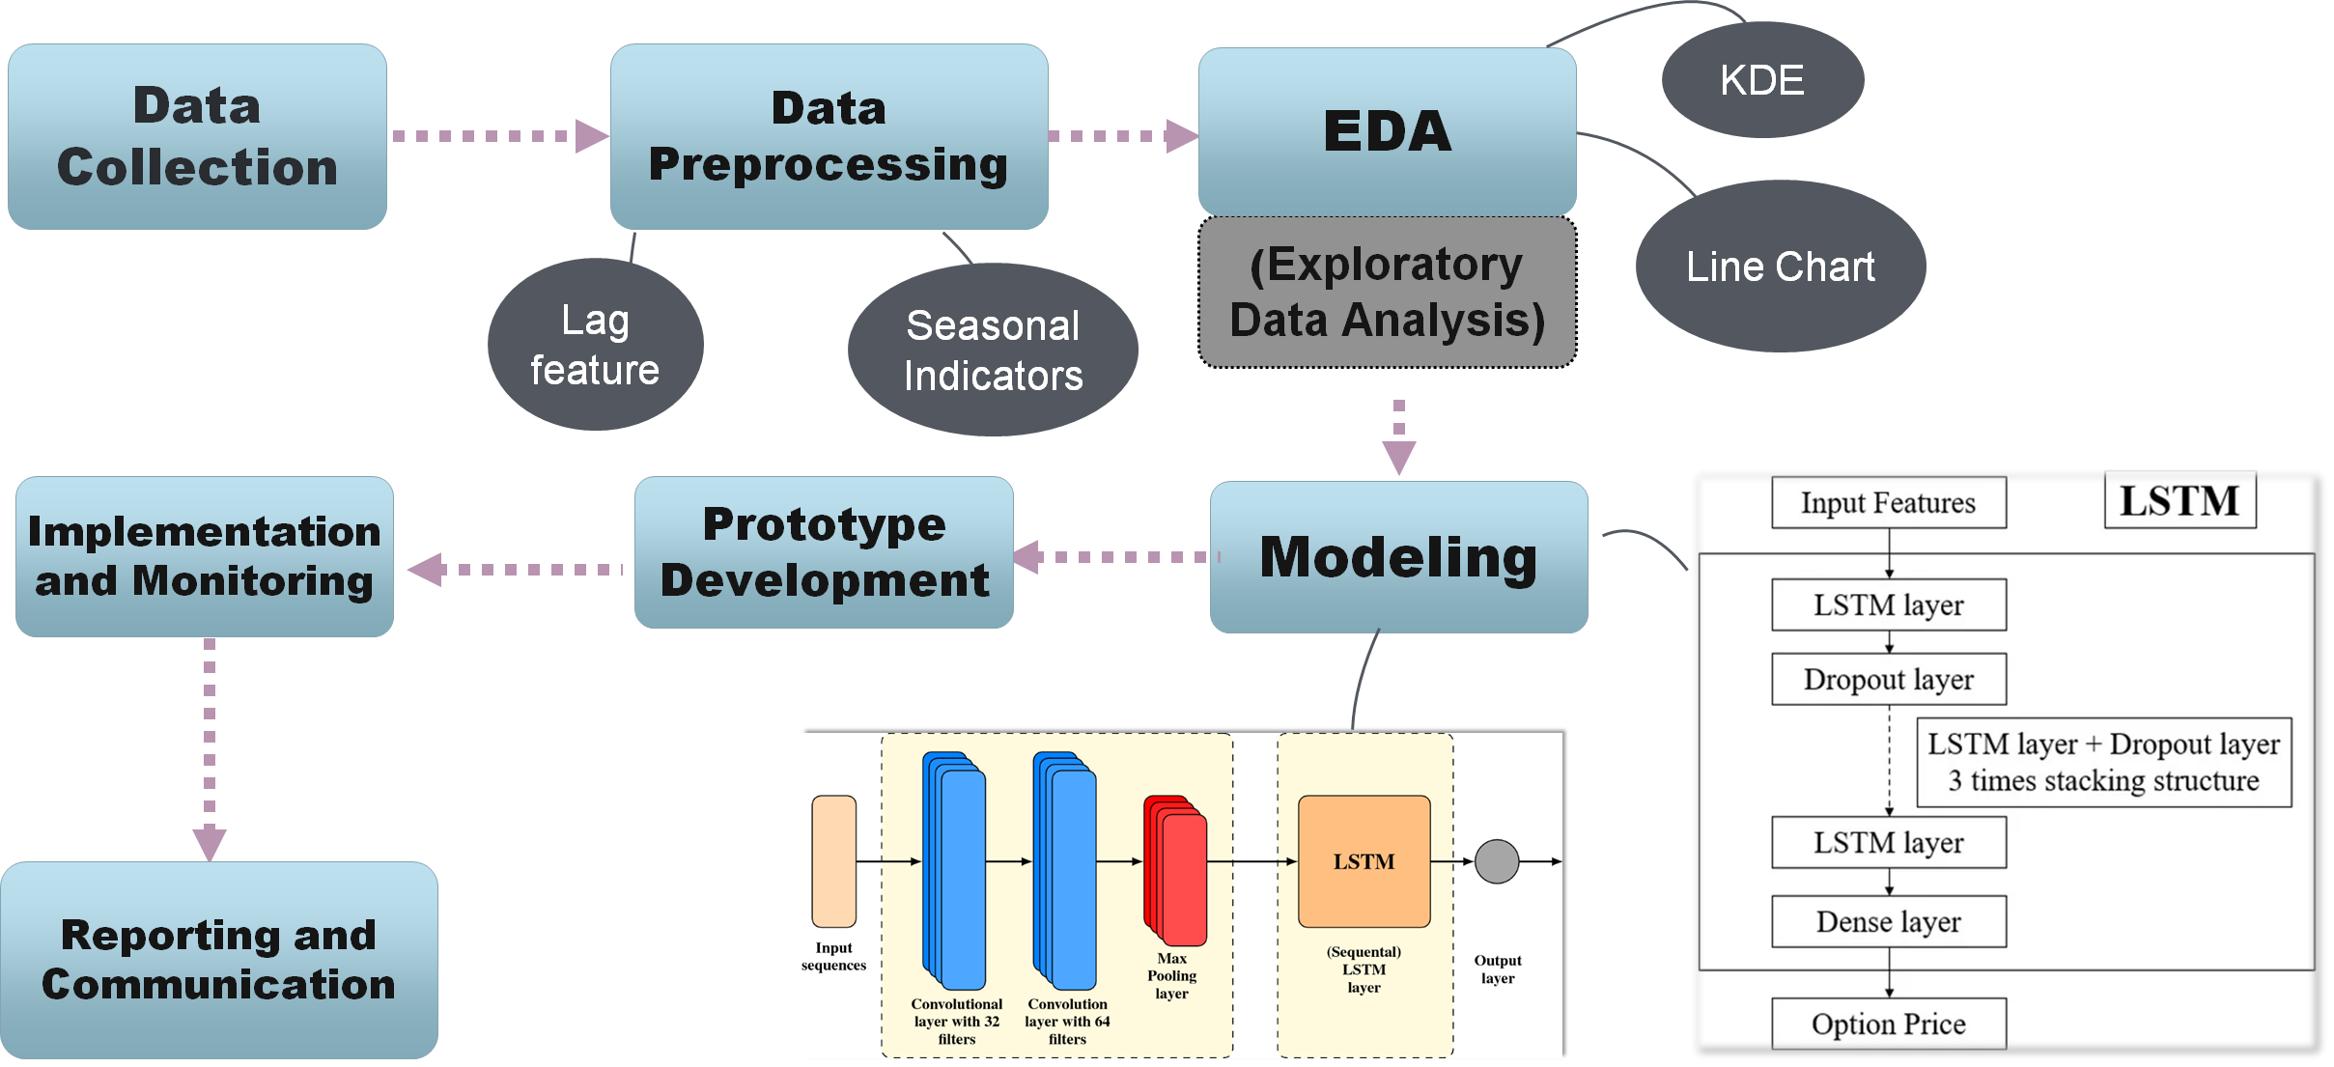
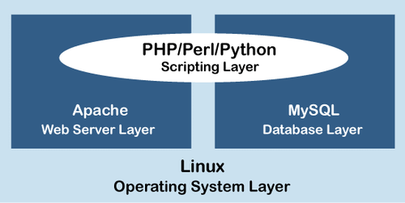
TECHNICAL APPROACH
Technology Used
1. Machine Learning Algorithms: Algorithms like Random Forest, Gradient Boosting Machines (GBMs), and Long Short-Term Memory (LSTM) networks will be used for time-series forecasting and regression analysis.
2. Data Collection from IoT and Remote Sensing: IoT sensors deployed on farms and satellite imagery will provide real-time data on crop health, yield forecasts, and soil conditions.
3. Cloud Computing: Large datasets will be processed using cloud computing for fast and scalable predictions, accessible to all stakeholders.
@SIH Idea submission- Template​

Slide 4
FEASIBILITY AND VIABILITY
Price Stability for Farmers: Accurate price forecasts allow farmers to plan planting and harvesting cycles, reducing the risk of income loss due to market volatility.
Improved Supply Chain Management: Wholesalers and retailers can optimize inventory management, reducing waste and ensuring steady supply to markets.
Better Policy Formulation: Governments can use the model to design price stabilization policies, improving economic resilience in agricultural sectors.
@SIH Idea submission- Template

Slide 5
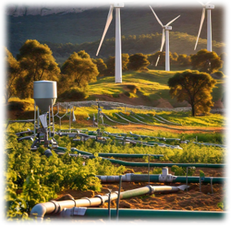
IMPACT AND BENEFITS
Sustainability of the Project
1. Reducing Food Wastage: The AI-ML model will allow for better alignment of production and demand, helping reduce food wastage by predicting surpluses or shortages in advance.
2. Promoting Sustainable Farming: By forecasting prices, farmers can make informed decisions on crop diversification and the use of sustainable farming practices that align with market trends.
3. Economic Sustainability: Stabilizing incomes for farmers and lowering risks across the supply chain contributes to long-term economic sustainability in rural communities.
Benefits
The deep learning model provides more accurate and dynamic forecasting of essential commodity prices. Traditional methods like ARIMA have limitations with nonlinear data, while deep learning models (LSTM) handle more complex patterns effectivel events (such as weather changes, geopolitical shifts).
@SIH Idea submission- Template

Slide 6

REFERENCE LINKS:
https://dfpd.gov.in/
https://igod.gov.in/organization/Sde83XQBYNG-XPnvjOsx
https://consumeraffairs.nic.in/
@SIH Idea submission- Template

